Slide 1


OBJECT ORIENTED PROGRAMMING THROUGH JAVA

Slide 2

L10-CONTROL STATEMENTS

Slide 3


Slide 4
CONTROL STATEMENTS:-
Java compiler executes the code from top to bottom. The statements in the code are executed according to the order in which they appear. However, Java provides statements that can be used to control the flow of Java code. Such statements are called control flow statements.
Java provides three types of control flow statements.
Decision Making statements
  if statements
  switch statement
Loop statements
  do while loop
  while loop
  for loop
  for-each loop
Jump statements
  break statement
  continue statement

Slide 5
Decision-Making statements:
As the name suggests, decision-making statements decide which statement to execute and when. Decision-making statements evaluate the Boolean expression and control the program flow depending upon the result of the condition provided. There are two types of decision-making statements in Java, i.e., If statement and switch statement.
If Statement:
In Java, the "if" statement is used to evaluate a condition. The control of the program is diverted depending upon the specific condition. The condition of the If statement gives a Boolean value, either true or false. In Java, there are four types of if-statements given below.
Simple if statement
if-else statement
If-else-if ladder
Nested if-statement

Slide 6

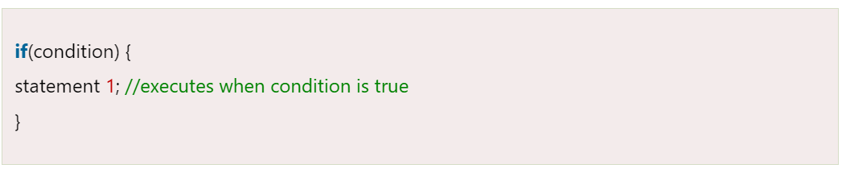
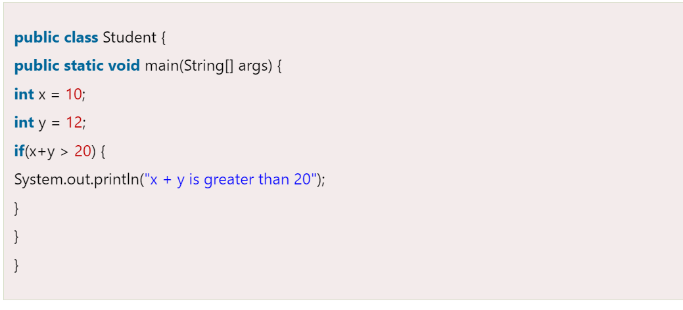
1) Simple if statement:
It is the most basic statement among all control flow statements in Java. It evaluates a Boolean expression and enables the program to enter a block of code if the expression evaluates to true.
Syntax of if statement:-

Slide 7

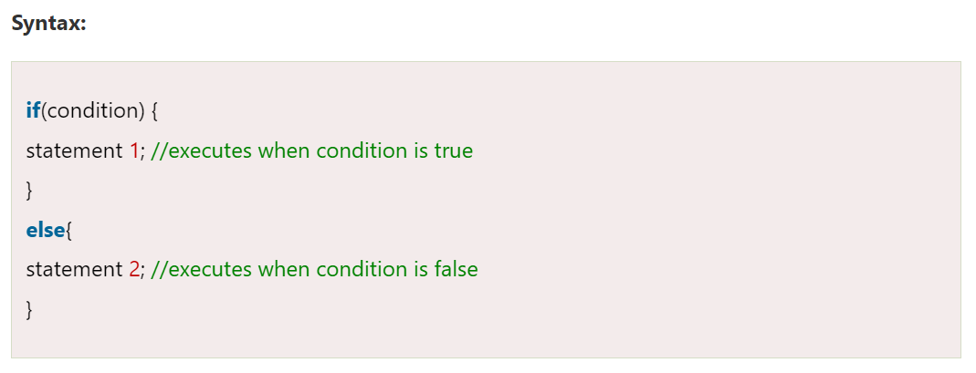
2) if-else statement:-
The if-else statement is an extension to the if-statement, which uses another block of code, i.e., else block. The else block is executed if the condition of the if-block is evaluated as false.

Slide 8
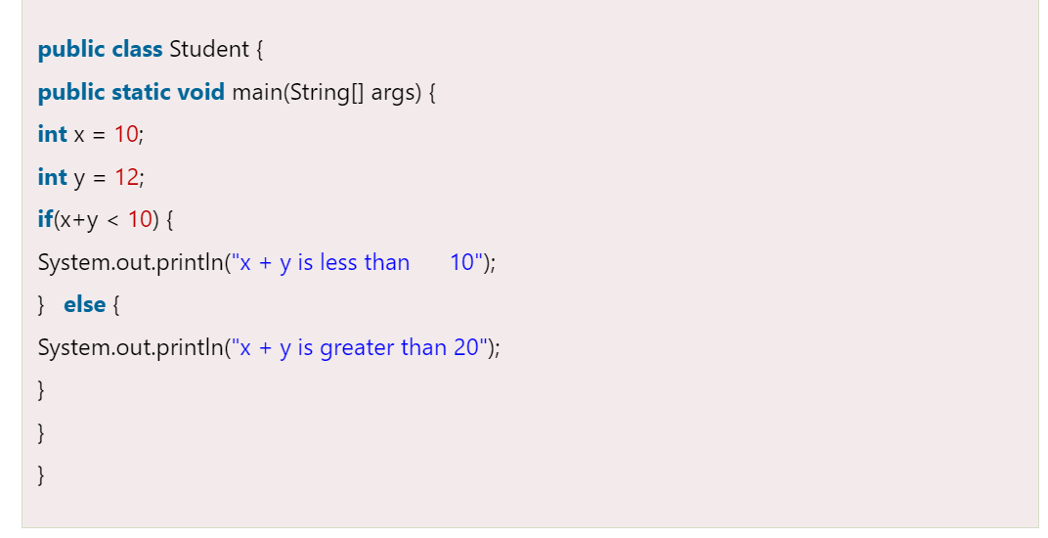

Slide 9

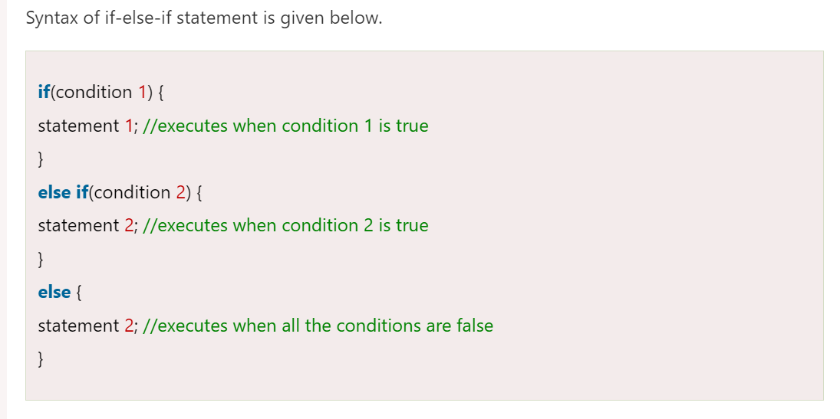
3) if-else-if ladder:
The if-else-if statement contains the if-statement followed by multiple else-if statements. In other words, we can say that it is the chain of if-else statements that create a decision tree where the program may enter in the block of code where the condition is true. We can also define an else statement at the end of the chain.

Slide 10

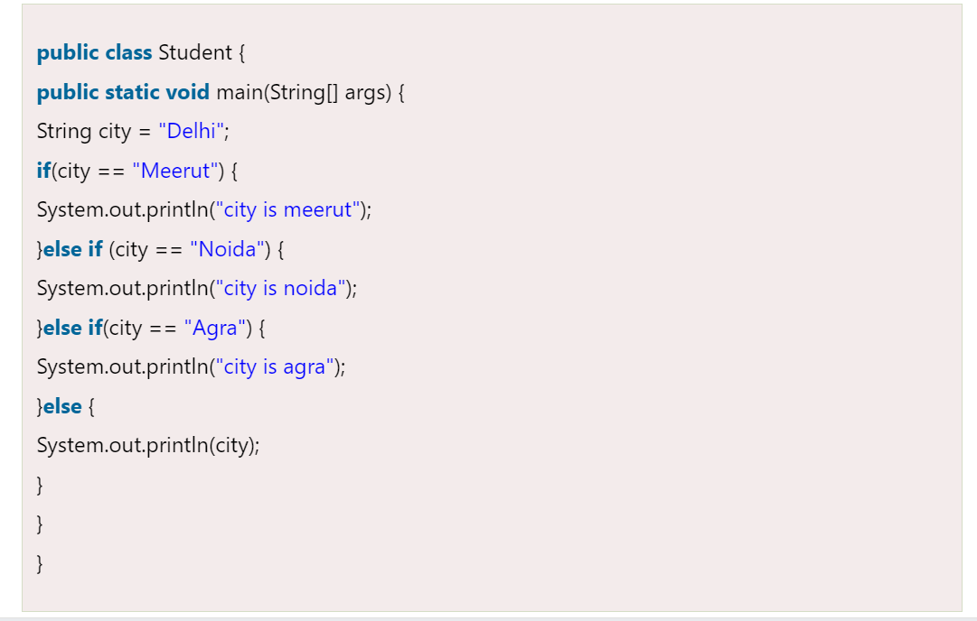

Slide 11
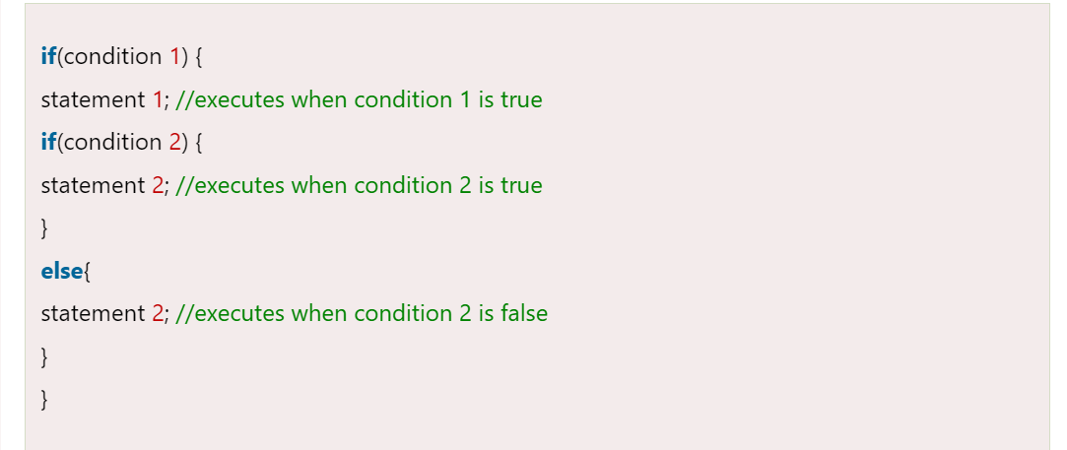
4. Nested if-statement:-
In nested if-statements, the if statement can contain a if or if-else statement inside another if or else-if statement.

Slide 12
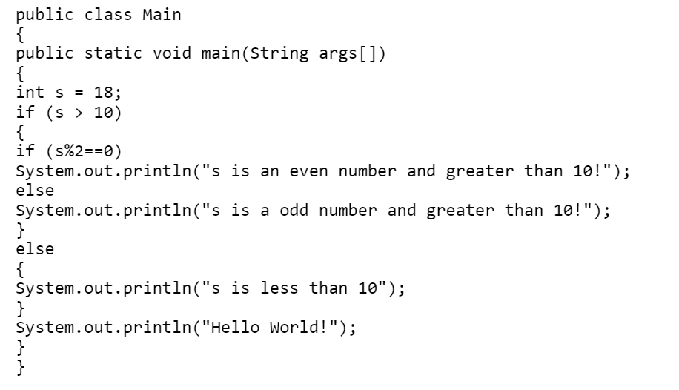

Slide 13
Switch Statement:
In Java, Switch statements are similar to if-else-if statements. The switch statement contains multiple blocks of code called cases and a single case is executed based on the variable which is being switched. The switch statement is easier to use instead of if-else-if statements. It also enhances the readability of the program.
The case variables can be int, short, byte, char, or enumeration. String type is also supported since version 7 of Java
Cases cannot be duplicate
Default statement is executed when any of the case doesn't match the value of expression. It is optional.
Break statement terminates the switch block when the condition is satisfied.
It is optional, if not used, next case is executed.
While using switch statements, we must notice that the case expression will be of the same type as the variable. However, it will also be a constant value.

Slide 14
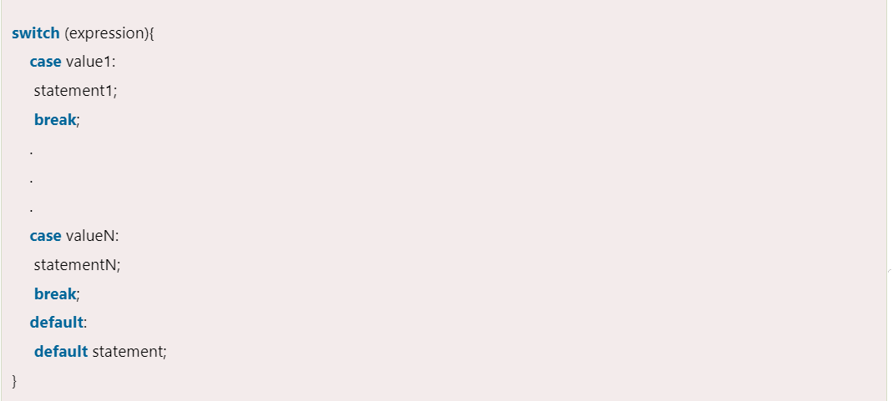

Slide 15
class SampleSwitch {
public static void main(String args[])
{
for(int i=0; i<6; i++)
switch(i)
{
case 0:
System.out.println("i is zero."); break;
case 1:
System.out.println("i is one."); break;
case 2:
System.out.println("i is two."); break;
case 3:
System.out.println("i is three."); break;
default:
System.out.println("i is greater than 3.");
}}}

Slide 16
Loop Statements:-
In programming, sometimes we need to execute the block of code repeatedly while some condition evaluates to true. However, loop statements are used to execute the set of instructions in a repeated order. The execution of the set of instructions depends upon a particular condition.
In Java, we have three types of loops that execute similarly. However, there are differences in their syntax and condition checking time.
for
while
do-while

Slide 17
while Loop: while loop repeats a group of statements as long as condition is true. Once the condition is false, the loop is terminated. In while loop, the condition is tested first; if it is true, then only the statements are executed. while loop is called as entry control loop.
Syntax: while (condition)
{
statements;
}
Program : Write a program to generate numbers from 1 to 20.
//Program to generate numbers from 1 to 20.
class Natural
{
public static void main(String args[])
{
int i=1;
while (i <= 20)
{
System.out.print (i + “\t”);
i++;
}
}
}

Slide 18
do…while Loop: do…while loop repeats a group of statements as long as condition is true. In do...while loop, the statements are executed first and then the condition is tested. do…while loop is also called as exit control loop.
Syntax: do
{
statements;
} while (condition);
Program: Write a program to generate numbers from 1 to 20.
//Program to generate numbers from 1 to 20.
class Natural
{
public static void main(String args[])
{
int i=1;
do
{
System.out.print (i + “\t”); i++;
} while (i <= 20);
}
}

Slide 19
for Loop: The for loop is also same as do…while or while loop, but it is more compact syntactically. The for loop executes a group of statements as long as a condition is true.
Syntax: for (expression1; expression2; expression3)
{ statements;
}
Here, expression1 is used to initialize the variables, expression2 is used for condition checking and expression3 is used for increment or decrement variable value.
Program : Write a program to generate numbers from 1 to 20.
//Program to generate numbers from 1 to 20.
class Natural
{
public static void main(String args[])
{
int i;
for (i=1; i<=20; i++)
System.out.print (i + “\t”);
}
}

Slide 20
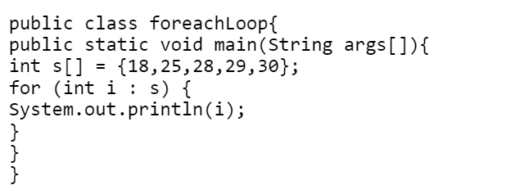
For-Each:-
The traversal of elements in an array can be done by the for-each loop. The elements present in the array are returned one by one. It must be noted that the user does not have to increment the value in the for-each loop.

Slide 21
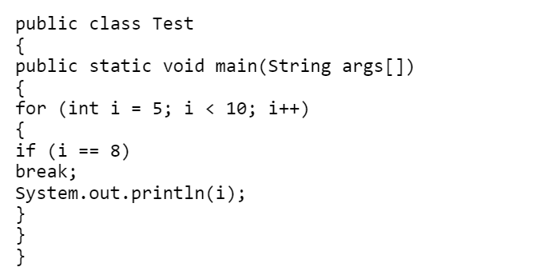
JUMP STATEMENTS
Java supports three jump statements: break, continue and return. These statements transfer control to another part of the program.
break:
  break can be used inside a loop to come out of it.
  break can be used inside the switch block to come out of the switch block.
  break can be used in nested blocks to go to the end of a block.
  Nested blocks represent a block written within another block.
·
Syntax: break; (or) break label; //here label represents the name of the block.

Slide 22
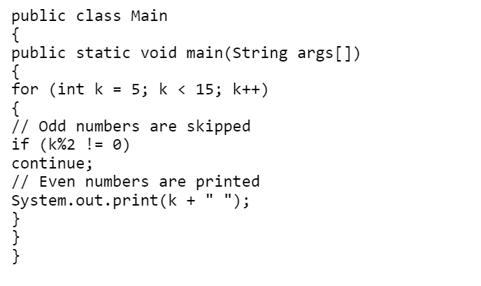
Continue:-
To jump to the next iteration of the loop, we make use of the continue statement. This statement continues the current flow of the program and skips a part of the code at the specified condition.

Slide 23
Next….
TYPE CONVERSION AND TYPE CASTING
Notes:
In Slide Show mode, click the arrow to enter the PowerPoint Getting Started Center.

Slide 24



